Slide 1
Branch + Blue Coast
Sales Slides
Tony Rappa | Strategic Alliances Manager

Slide 2


Workers need faster access to wages, now more than ever before.
COVID-19 has hit lower-income workers most
Movement away from cash has created gaps
Growth in gig employment has set new expectations
Traditional payment methods haven’t caught up.

Slide 3

Branch is a free employee benefit* improving financial health for businesses and workers.
*No setup costs, subscriptions or access fees
Employer Payments Platform
Digital Wallet
+
Branch Card
+
Instant Pay

Slide 4

Branch + (Advisor) helps solve real business + payroll problems:
Providing EWA for All Employees
Save Money by Reducing Paper checks or Replacing Paycards
Automate Payouts - Tips, Miles, Last Pay
Help Attract and Retain Quality Talent
Offer Financially-Inclusive Wellness
Simplify Payroll
Save Time + Money
Competitive-edge
Attracting Talent
Pay Employees
Faster

Slide 5

Replace Paycards +
Paper Checks
Reduce time & costs related to cutting paper checks or managing paycards
Provide fee-free digital banking and debit card to all employees
No-hassle, no-cost way to pay people faster, even on day one
Branch handles all support needs
Built in EWA & 2-Day early DD
1 in 3
Low-income workers are underbanked or unbanked
Save $2,000/year per 10 employees

Slide 6

Earned Wage Access
Free for you & your employees
No pre-funding, escrow, or third-party risk
No extra steps or changes to payroll
Prevents overdraft and maintenance fees, which perpetuates the cycle of debt
Improve retention and employee morale
Aligned with CFPB Advisory Guidelines
2x
Workers more likely to apply if EWA is offered

Slide 7

Digital Tips +
Disbursements
Instantly send digital tips, mileage reimbursements or other one-off payments
No additional payroll steps
No manual data entry required; we automate the process for you
Eliminates cash-on-hand needs
Better cash flow: no escrow or pre-funding
“
What Branch offers is stylists to get their wages faster, and owners to control cash flow.”
Raj Mahajan
President ProPoint Solutions

Slide 8

1099 + Gig Payouts
Workers can get their wages paid out instantly after job completion (and even multiple times a day) for Free!
Flexible integration options
Save by eliminating ACH + Instant fees
Tax-withholding and 1099 form generation options
90 second onboarding and immediate access to Apple Pay or Google Pay card
$2/daily
Instant or Express Pay fees
on average gig platforms

Slide 9
(Advisor) + Branch
Modern Digital Payments
Improved Cashflow
Switch to contactless, cashless payments — no pre-funding.
Quick Setup
Flexible integration options, get running in as little as a week.
Great Support
Our US-based team is here to help, you & your employees.
Compliant
Our employer-based offering is SOC-2 and CFPB-adherent.

Slide 10


Getting Started with Branch is Easy!
1
Sign with Branch
No minimums, No fees
Your dedicated Branch Success Team will:
Review and align on your companies priorities
Help provide guidance + requirements on data exchange and setup
Create custom communication materials
Provide multi-level leadership training
2
Verify employee data route
3
Train leaders & distribute
marketing materials
4
Go live!

Slide 11





Emerging leader in employee-centric fintech & financial wellness
Awards
2020 Webby Award Winner
Apps - Financial Service Banking
2020 Lendit Fintech Award Winner
Excellence in Financial Inclusion
G2 Leader - Winter 2021
4.7 Stars
Branch is working on big ideas to help solve the financial challenges faced by America’s 80 million hourly workers by partnering with the companies they work for to streamline payments.
Wellness Partnerships

Slide 12
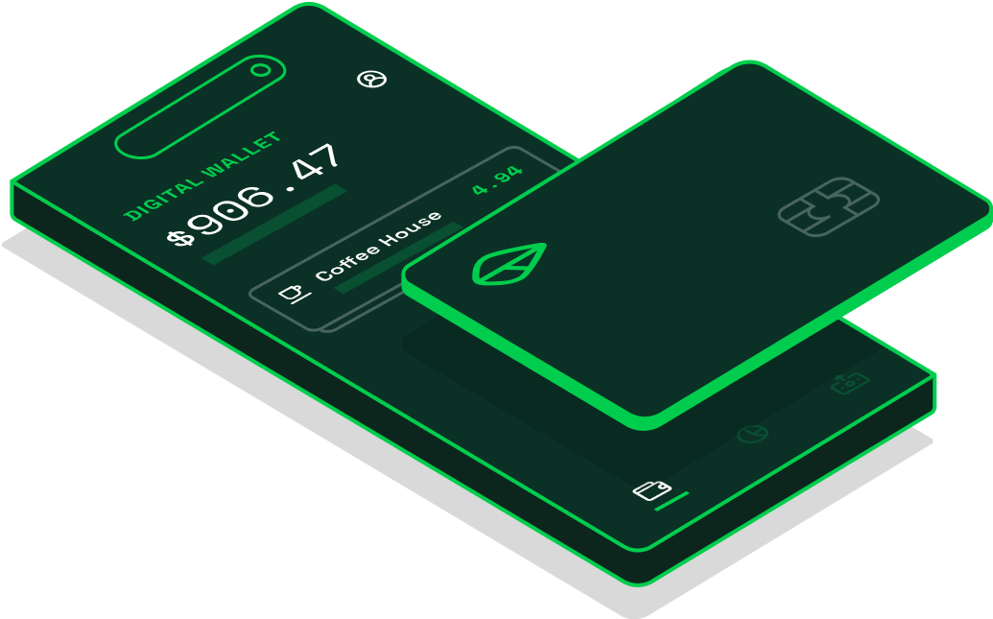


Tony Rappa
STAY IN TOUCH
Strategic Alliances Manager
651.341.5522
tony.rappa@branchapp.com
branchapp.com ›
Banking Services provided by Evolve Bank & Trust, Member FDIC. The Branch Mastercard Debit Card is issued by Evolve Bank & Trust pursuant to a license from Mastercard and may be used everywhere Mastercard debit cards are accepted.
© Branch 2021 - All Rights Reserved

